Slide 1
Transportation Cost and Market Growth

Slide 2
Major Causes of Reduced Transportation Costs Before Civil War
Turnpikes
  1790-1820
  60% in New England
Canals
  1790-1840-Erie Canal 1825
  Northeast and Midwest
Steamships
  First used widely in 1820
  Rivers and Great Lakes

Slide 3
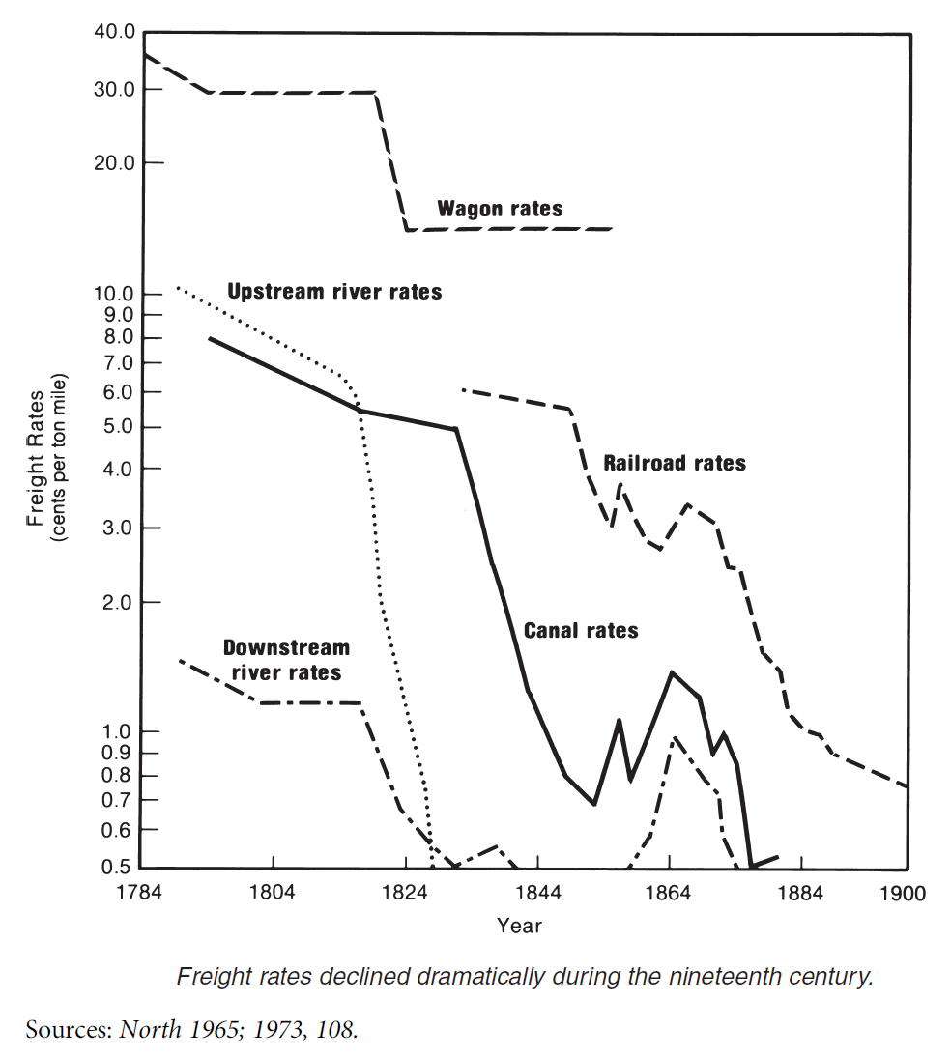
Reduction in Transportation Costs
Inland Freight Rates, 1784–1900
Turnpikes and road buildings
Railroads not important until after Civil War
Steamships
Eliminate difference between upstream and downstream rates

Slide 4
Railroads
Railroad technology is available in 1830
Used on a small scale until the after the Civil War Why?
  While RR are more efficient in some places because they are not dependent on water
  Marginal cost of moving goods on existing canals and rivers is low
  Large capital costs
  Dependent on increase in Demand

Slide 5
Is Transport a Public or Private Good?
Is MC of one more person using it zero?
  Maybe, depends on number of users
  Not true for Railroads
Is the cost of excluding high?
  Maybe
  True for most roads and water ways
  Not true for Steamships and Railroads

Slide 6
How important is Government Involvement?
After Jefferson’s Embargo of 1807, Sec of Treasury Albert Gallatin asks Congress for Federal Funding for a highway improvement program in 1808
  20 million over 10 years
  It was vetoed, not implemented until 20 century
  Most of the tranportation innovations of this period came from the private sector with some government help, mostly from state and local governments

Slide 7
Funding Turnpikes and Roads
Rates of return for both Turnpike and Canal stock are low
  Not surprising cost of excluding non-payers is high
  Social rate of return is higher than private rate of return
  Social rate of return includes increase in land values along route, lower transport prices, lower commodity prices, value of time saved

Slide 8
Why were they built?
Other ways to capture the gain
  Increased land values along the route
  Increased value of business in cities and town along the route
  Evidence that towns did put pressure on land and business owners to invest (reduce free rider problem)
Not surprising that state and local government investment was greater than federal investment

Slide 9
Annual Construction (Gross and Net) and Tonnage of Steamboats in Operation on Western Rivers, 1811–1868
Steamships are private goods, increase without government involvement

Slide 10
Results
Lower transportation costs
Increase volume of trade
 | 1800 | 1825
wagon | $.30 | $.15
Down river | $.015 | $.005
Up river | $.09 | $.01
Erie Canal |  | $.015

Slide 11
Reduction in prices
Cincinnati Wholesale Prices as a Percentage of Philadelphia, New York, and New Orleans Wholesale Prices, 1816–1860ª

Slide 12
Other effects
Increase in Urbanization
Increase in Land values
Increase in shipping distance, increases market size
  Industrialization

